Slide 1




Deep Learning-Based Skin Disease Classification
Presented by - Aditya Kumar Singh

Slide 2
Abstract
The project aims to develop a robust deep learning model for the automatic classification of common skin diseases such as acne, skin redness, and bags under the eyes from facial images. Given the impact these conditions have on individuals' self-esteem and quality of life, an accurate and timely diagnosis is essential. The model will be designed to generalize across various demographics, skin types, and environmental conditions, providing valuable assistance to dermatologists and skincare professionals in their diagnostic processes.

Slide 3
Introduction
Skin diseases, including acne, redness, and bags under the eyes, are widespread and can significantly affect individuals' mental and physical well-being. Accurate diagnosis of these conditions is challenging due to the variability in skin types, lighting conditions, and image angles. Traditional diagnosis relies heavily on visual inspection by dermatologists, which can be subjective and prone to errors. The advent of deep learning and computer vision offers an opportunity to enhance diagnostic accuracy through automated image analysis, thus improving patient outcomes and reducing the burden on healthcare professionals.

Slide 4
Objective
The primary objective of this project is to design and implement a deep learning model capable of accurately classifying skin diseases from facial images. The model will focus on three specific conditions: acne, skin redness, and bags under the eyes. It aims to generalize well across diverse populations and varied conditions, assisting dermatologists in making precise and timely diagnoses, thereby improving the quality of care provided to patients.

Slide 5
Methodology
Data Collection and Preprocessing: The dataset includes facial images of individuals with skin conditions (acne, redness, bags under the eyes), captured from three angles (front, left, right). Demographic data (age, gender, ethnicity) is used to enhance model generalizability. Preprocessing steps include resizing, resolution adjustments, and color normalization.
Model Architecture: A deep learning model utilizing Convolutional Neural Networks (CNNs) will be developed for effective feature extraction and classification of skin conditions. The architecture will strike a balance between complexity and interpretability to ensure accurate learning of skin disease features.

Slide 6
Methodology
Training and Evaluation: The model will be trained on the preprocessed dataset, with performance optimized for accuracy, precision, recall, and F1-score. Data augmentation, regularization, and cross-validation will be employed to enhance generalization and prevent overfitting. The model's performance will be validated using a separate test set.
Fine-tuning and Optimization: The model will undergo iterative fine-tuning based on real-world feedback to continually improve accuracy and robustness, maintaining its value as a diagnostic tool.

Slide 7
Implementation

Slide 8
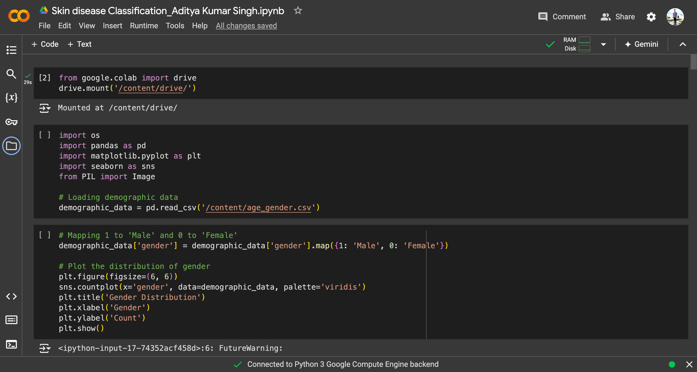

Slide 9
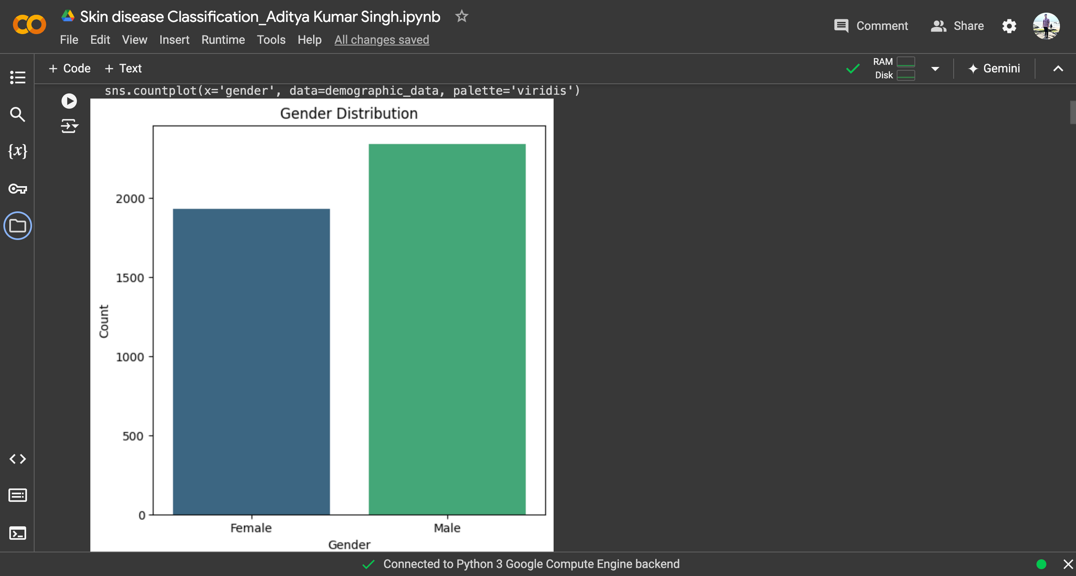

Slide 10


Slide 11
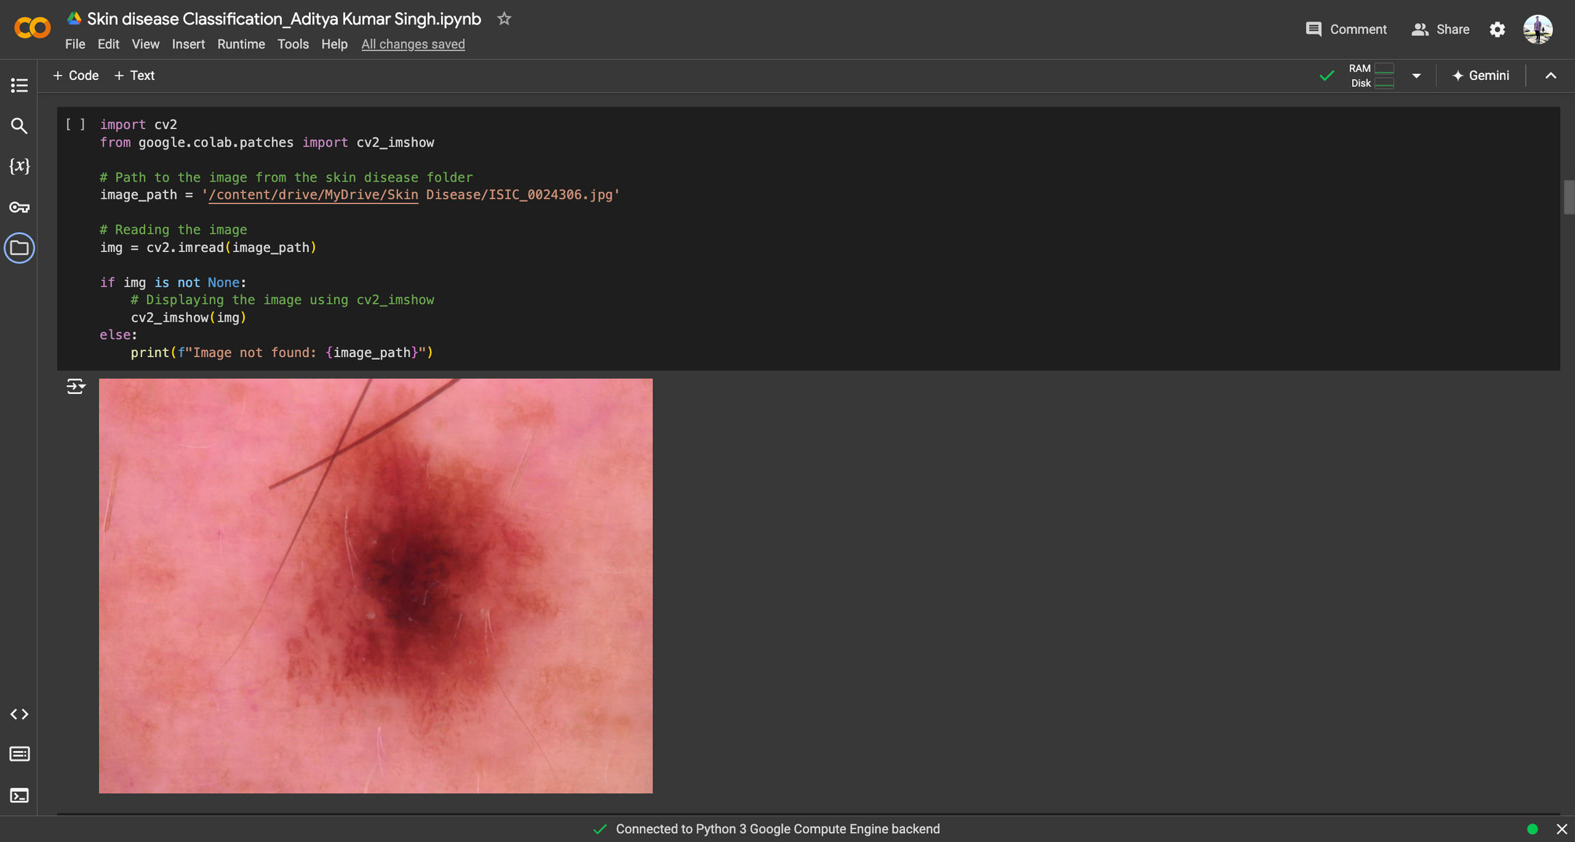

Slide 12


Slide 13
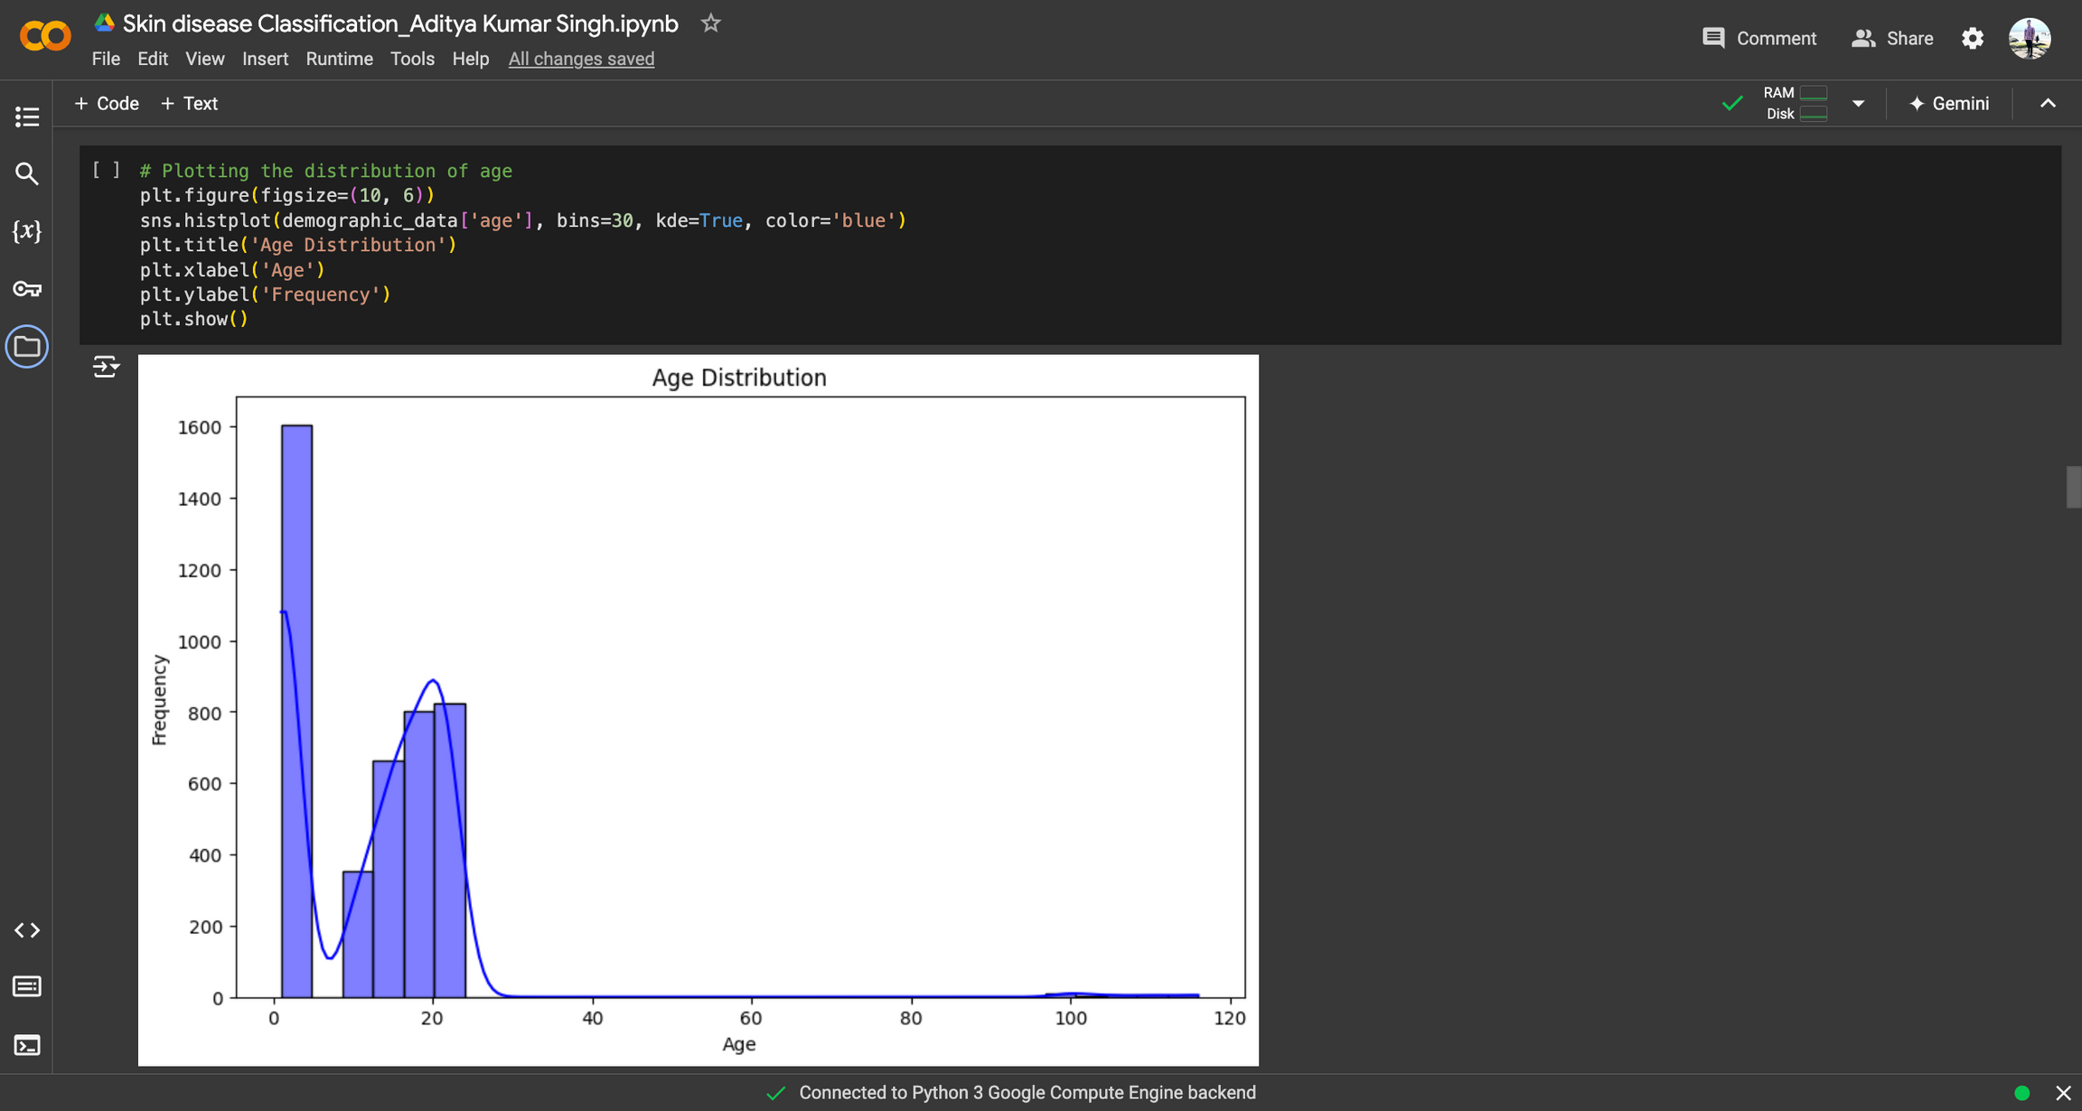

Slide 14
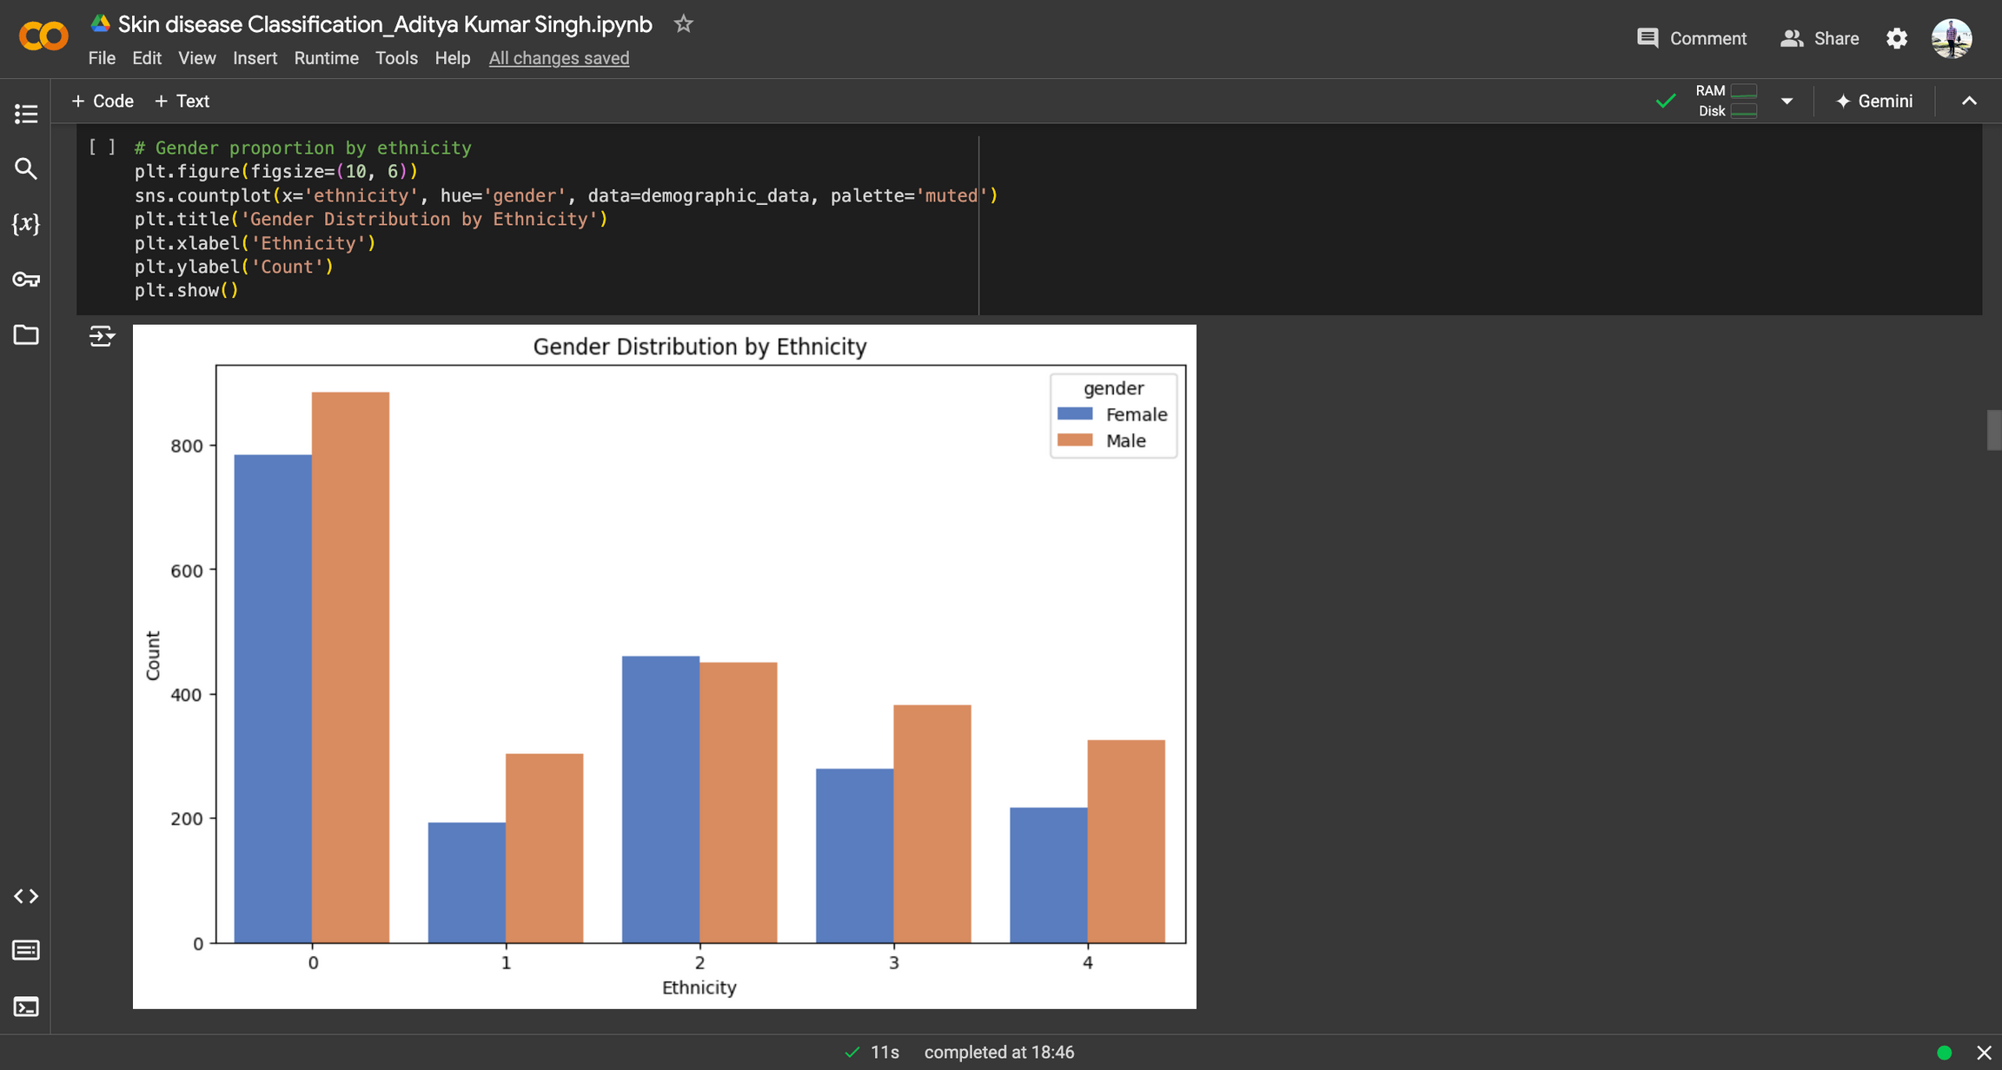

Slide 15
CNN model for skin disease classification

Slide 16


Slide 17
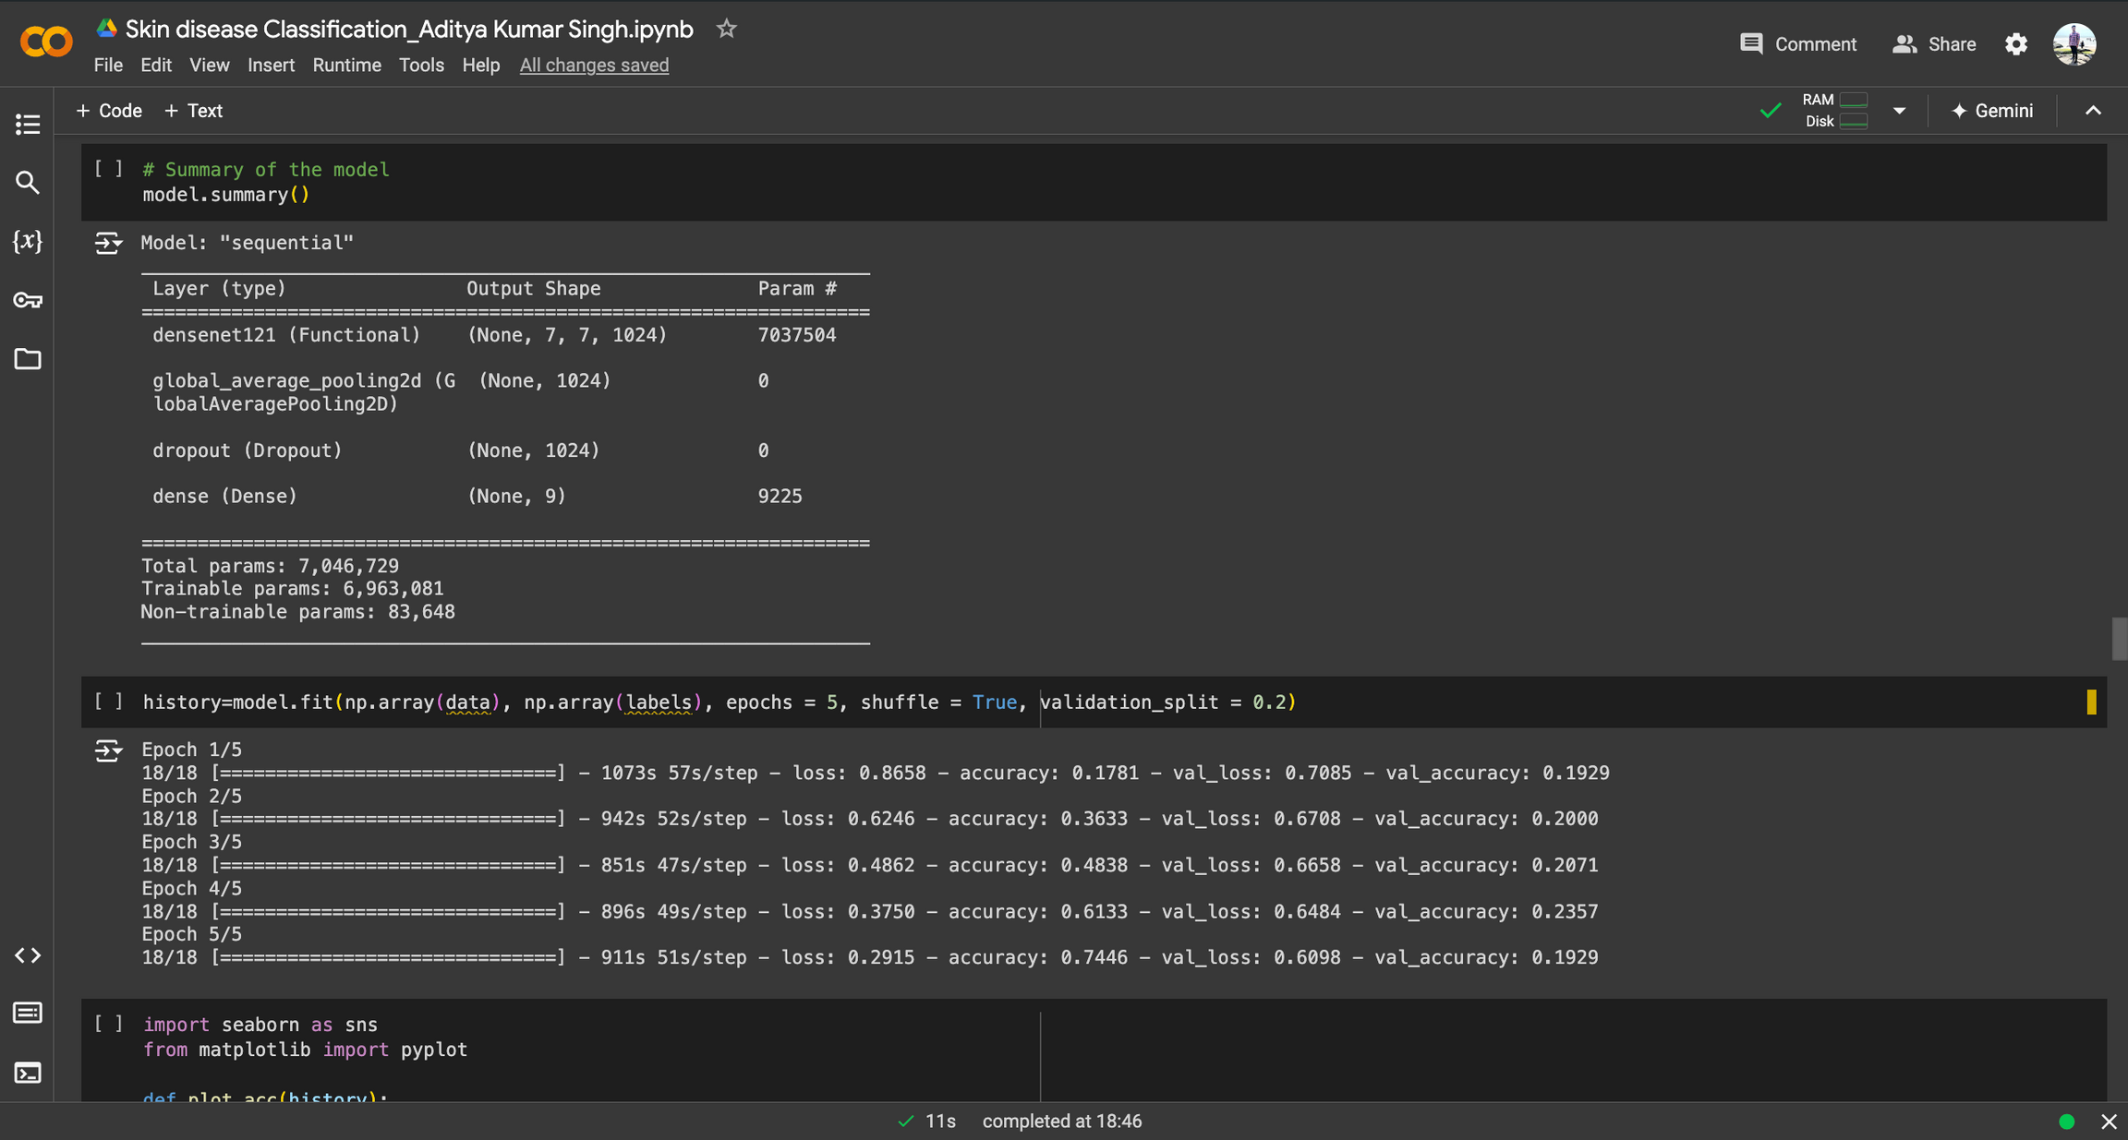

Slide 18
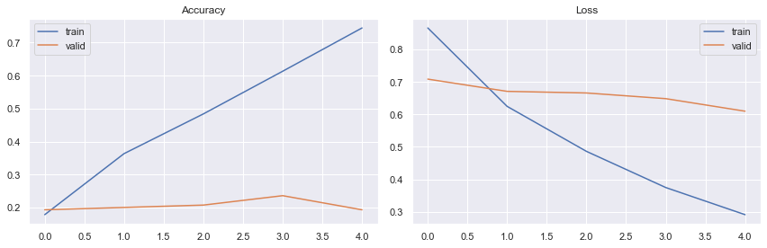

Slide 19
Conclusion
By developing an advanced deep learning model for skin disease classification, this project aims to significantly enhance the diagnostic process for conditions like acne, skin redness, and bags under the eyes. The model's integration into clinical practice will support dermatologists in making more accurate and timely diagnoses, ultimately improving patient outcomes and advancing the field of dermatology.

Slide 20
THANK YOU

